Slide 1
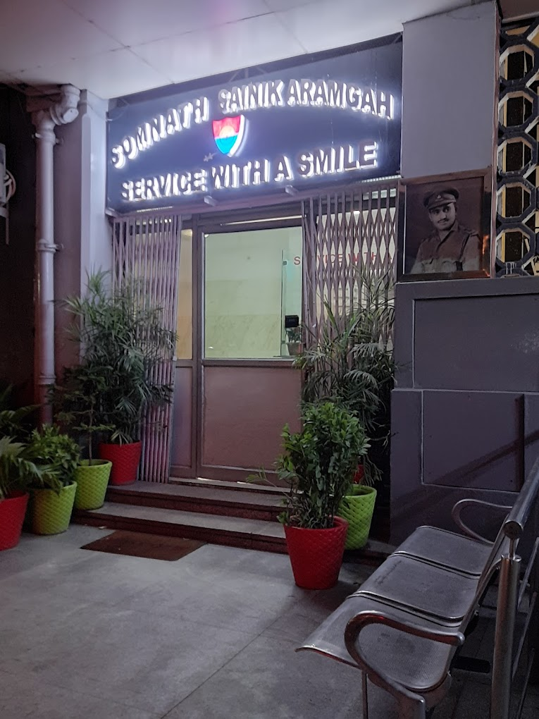
Somnath Sainik Aramgrah
A Convenient Transit Hub for Defence Personnel

Slide 2
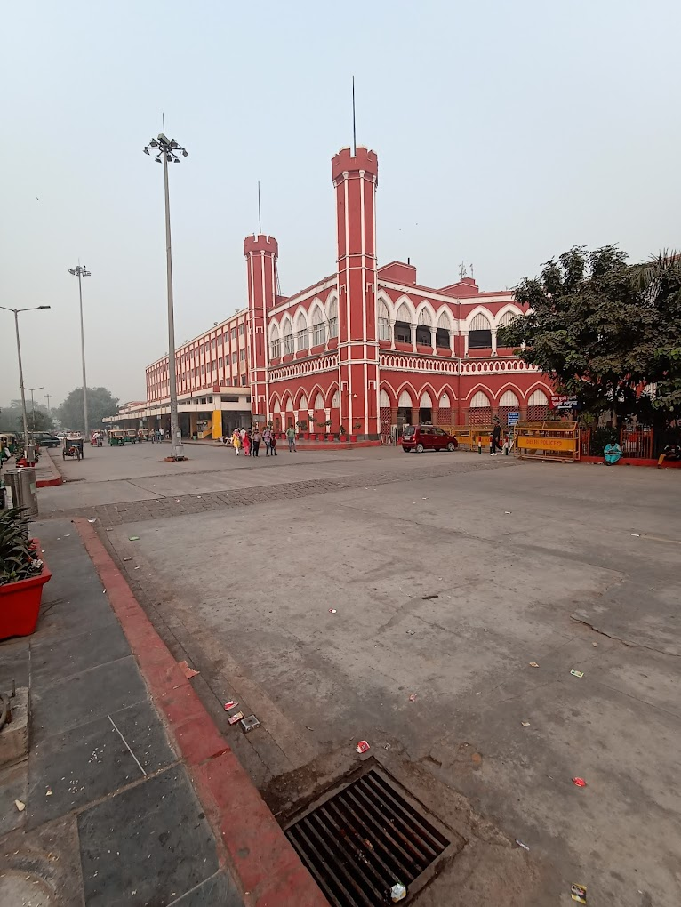
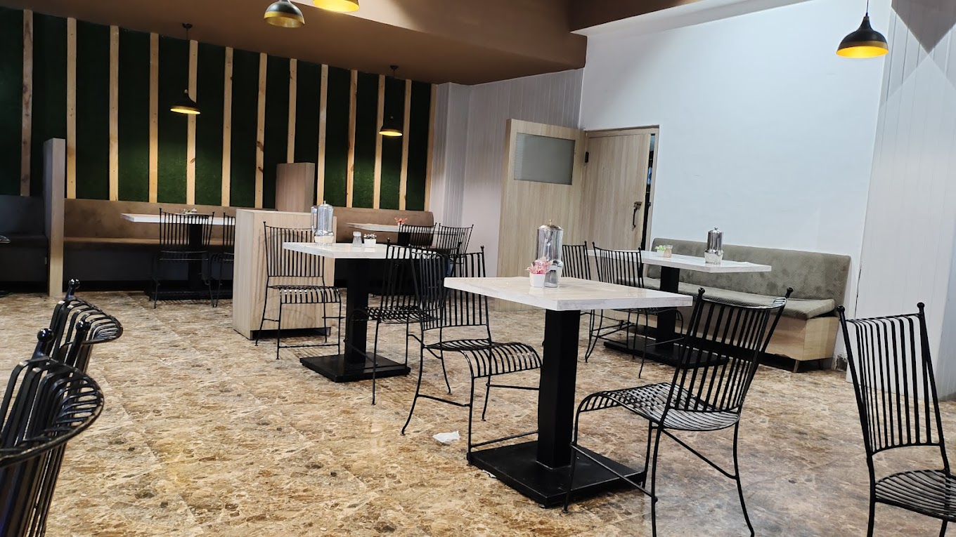
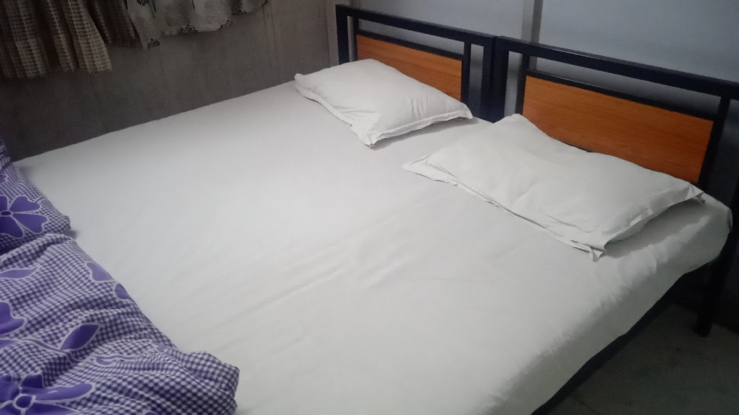
Location & Images
Located at Old Delhi Railway Station,
Platform No. 1

Slide 3
Introduction to Somnath Sainik Aramgrah
Background: Originally named Auchinleck Sainik Aramgrah, renamed after India’s first PVC awardee.
Purpose: Transit accommodation for defence personnel, providing safety, comfort, and affordability.
Location: Directly above Platform No. 1, Old Delhi Railway Station – convenient access.

Slide 4
Key Amenities at Somnath Sainik Aramgrah
Accommodation: Dormitory-style with bunk beds and fans for ventilation.
Exclusive facilities for soldiers, both single men and those with families. Dining:
On-site restaurant offering affordable meals, though service can be slow.
CSD Canteen with daily essentials at low prices.

Slide 5
Facilities and Services
RO Water: Clean drinking water is available.
Cloak Room: Secure storage for baggage and carry bags.
Cafeteria & MI Room: Separate spaces for service men.
Hygiene and Supplies: Basic cleaning materials available for purchase..

Slide 6
Booking and Entry Requirements
Eligibility: Serving defense personnel and families.
Fees: INR 30 per person for single men; card payment only.
ID Verification: Defense ID card required for entry and payment.
Operating Hours:
Breakfast: Up to 10:00 AM
Lunch: From 12:30 PM

Slide 7
Pros and Cons of Staying at Somnath Sainik Aramgrah
Pros:
Low-cost accommodation
Central location, secure and convenient
Canteen and cafeteria for convenience
Cons:
Occasional delays in food service
Bedsheet cleanliness and infrequent changes

Slide 8
Tips for Travelers
Bring Essentials: Card for payment, ID for verification.
Plan Your Stay: Ideal for a 24-hour stay, ideal for short transit periods.
Additional Tips: Nearby saloon facility for quick grooming, accessible cloakroom for convenience.

Slide 9
Nearby Attractions and Accessibility
Attractions Close to Old Delhi Station: Red Fort, Chandni Chowk.
Ease of Access: Centrally located, allowing defense personnel to explore Delhi conveniently during transit.

Slide 10
Conclusion and Recommendations
Summary: Safe, secure, and affordable stay option for soldiers.
Recommendation: Highly recommended for defense personnel seeking comfort and security close to Delhi Junction.

